Slide 1
A Patient Safety Lens on Electronic Health Record Downtime
Katherine R. Zigmont, BSN, RN, CPPS, Clinical Liaison Nurse
Academic Medical Center PSO
Mary Devine, MPH
Emergency Management Director
Boston Children’s Hospital
Alison Parmar, JD
Senior Administrative Manager, Emergency Preparedness
Massachusetts General Hospital

Slide 2
Mission Statement AMC PSO
The mission of the AMC PSO is to foster a culture of safety across our membership through the collection, aggregation and analysis of data. These activities serve as the foundation for convening providers, in a secure environment, to accelerate our understanding of, and implement evidence-based solutions for preventing avoidable harm.

Slide 3
AMC PSO Member Engagement
Goal: Develop a member-driven, consensus-based document to support our Patient Safety and Risk leaders in engaging IT and operational leadership in the mitigation of patient safety events related to EHR Downtime events
Process:
  Literature Review
  Convening of AMC PSO member subject matter experts in Information Technology, Emergency Preparedness, Clinical Operations, Risk Management and Patient Safety for further insights
  Develop and promulgate best practice recommendations

Slide 4
Process for Convening
Creating a Culture of Caring… Fostering a Culture of Safety
The AMC PSO convenes members in response to high risk safety events in a secure, federal protected environment
Convening sessions are built around recent adverse events/emerging patient safety risks
Triggering events are carefully dissected to reveal inherent systems errors, particularly from a Culture of Safety perspective
Sessions include facilitated discussions led by organizational risk and safety leaders and subject matter experts
Following each meeting, actionable reports providing best practice models and summaries of key findings, are distributed across the AMC PSO

Slide 5
Why focus on EHR Downtime
Background: Survey of 59 Healthcare Systems
96% of institutions reported at least one unplanned downtime
  70% had at least one unplanned downtime > 8 hours
Three institutions reported one or more patients were injured as a result of a downtime
70–85% had implemented practices to prepare/deal with a downtime event, but few were followed
Most institutions had only partially implemented comprehensive contingency plans for unplanned downtimes*
  *Sittig DF, Gonzalez D, Singh H. Contingency planning for electronic health record-based care continuity: A survey of recommended practices, International Journal of Medical Informatics, July 2014. Referenced from https://www.researchgate.net/publication/264546263.

Slide 6
The Toll of Downtime
100% reliable systems do not exist
Downtimes are inevitable and costly
The study showed:
  For every minute of downtime, the average hospital spends 1.4 minutes to perform required tasks without automation
  1 minute of unavailable system time = 4.5 minutes of staff time to re-enter the data once the system was operating
Costs of downtime:
  $264/min for a 500-bed hospital
  $1000/min for a three hospital integrated delivery network (IDN} with 1,400 beds
Over one year, each 1 percent of downtime can translated into an additional $1.4 million in operating costs for a 500 bed hospital and as much as $10 million for the IDN*
*Anderson, M.: The toll of downtime. Healthcare Informatics 2002. 19:4

Slide 7
Case Example
52 yo female with PMHx of HTN, Obstructive Sleep Apnea, Congestive Heart Failure and Carotid Dissection admitted with shortness of breath and abdominal pain/distension
CXR – cardiomegaly and right pleural effusion
Chest CT – pericardial effusion, no tamponade
Routine abdominal CT ordered @ 1:35 am
11:25am, patient with acute SOB, chest and abdominal pain
9:35pm, abdominal CT done but not read by Radiology due to other “STAT” studies
Next morning, the clinical system went down for 8 hours. When provider called for Abdominal CT results, they were not read and the provider was unaware of downtime procedure for accessing results.
That evening, the patient arrested. During the code, STAT read of Abdominal CT requested and critical finding of dissection of the thoracic/abdominal aorta was found. This was confirmed on autopsy.

Slide 8
Developing the Framework to Address the Issues

Slide 9
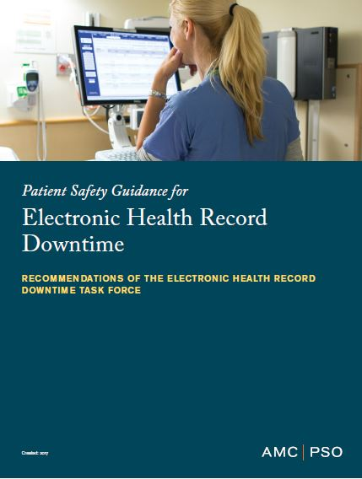
Framework Organized by Risk
Preparing for EHR Downtime
Activating EHR Downtime Response
Communications and Messaging Strategies
From Electronic to Paper-based Systems
Increasing Workforce Capacity and Capability
Monitoring Patient Safety and Quality
Planning for Recovery and Deactivation
Leveraging Lessons Learned

Slide 10
1. Preparing for EHR downtime
Creating Redundant Systems
Performing a System Inventory and Workflow Risk Assessment
Conducting Downtime Drills

Slide 11
2. Activating EHR Downtime Response
Downtime Alert and Notification
Command Center Activation and Operations
Establish Situational Awareness

Slide 12
3. Communication and Messaging Strategies
Internal Communications
External Communications
  ‘During a recent downtime, there was a lot of uncertainty about the last time medications were administered. Patients and their families were uninformed and many seemed to not understand why things were more chaotic than usual and why we were not scanning medications or using the computer.’
Unintended Communications: Controlling and Leveraging Social Media

Slide 13
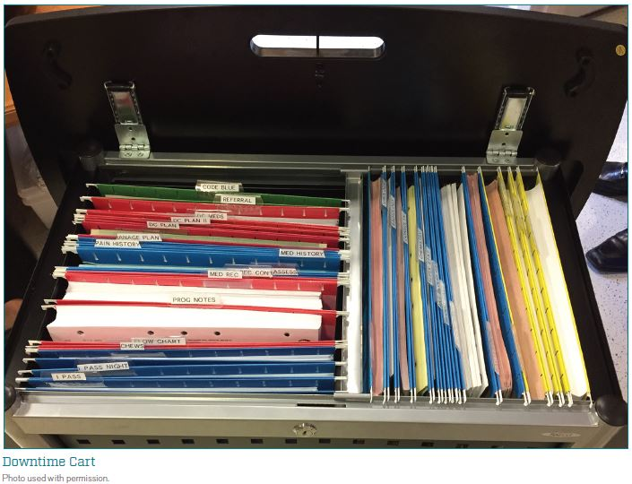
4. From Electronic to Paper-based Systems
Paper Documentation Strategies and Logistics

Slide 14
4. From Electronic to Paper-based Systems (cont’d)
Clinically Vulnerable Areas and Workflows
    Pharmacy
    Laboratory
    Blood Bank
    Radiology and Imaging
    Infant Security
    Oncology/Critical Care/Transplant/Nutrition Services
    Patient Access and Identification

Slide 15
5. Increasing Workforce Capacity
Recruit Additional Workforce to Meet Downtime Needs
Provide Workforce Support for Extended Response

Slide 16
6. Monitoring Patient Safety and Quality
Safety Event Reporting and Response
    EHR downtime that lasts several hours can impact safety event reporting system.
    There is often no predefined safety reporting process for an extended downtime and no paper version of our safety reporting forms.
Management, Quality & Regulatory Reporting

Slide 17
7. Planning for Recovery and Deactivation
Planning for Recovery and Deactivation
    System Restoration Strategies
    Electronic Health Record Restoration Strategies

Slide 18
8. Leveraging Lessons Learned
PATIENT SAFETY PRIORITY
Lessons learned are maximized and shared with all stakeholders
ACTION PLAN CHECKLIST
Patient Safety is included in “Hotwash” and After Action Review (AAR) Submit your lessons learned to the Patient Safety Organization (PSO) as Patient Safety Work Product Request a safe table convening of the AMC PSO, as needed

Slide 19
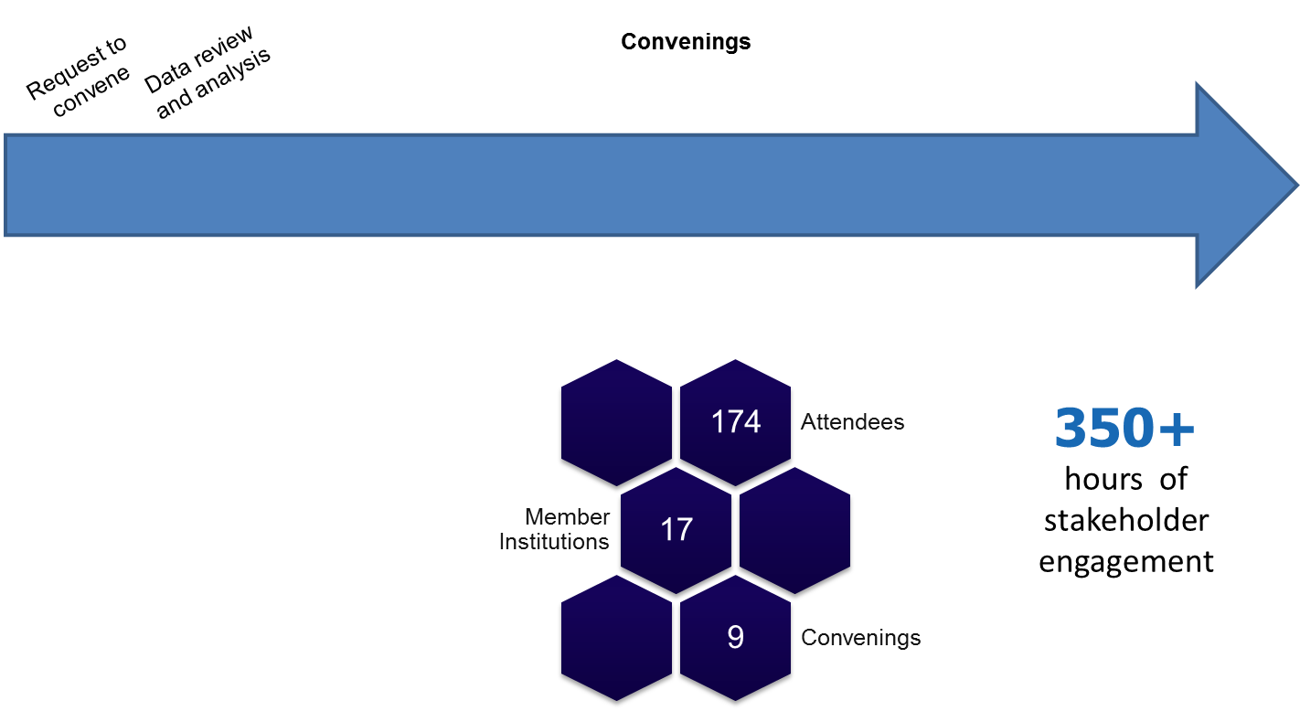
Safe Table Participation
Dec Jan Feb Jun Jul Sep Dec Feb Mar Apr May
2015 2016 2017

Slide 20
Guideline Development
Embodies the following premise:
    Developed under the auspices of the AMC PSO
    Consensus-based recommendations for informational purposes; not be construed or relied upon as a standard of care
  Promulgated as educational guidance
  Institutional responsibility:
      Read these guidelines and accept, modify or reject these recommendations based on their own institutional resources and patient populations
      Continue to review and modify these recommendations as the field continues to evolve

Slide 21
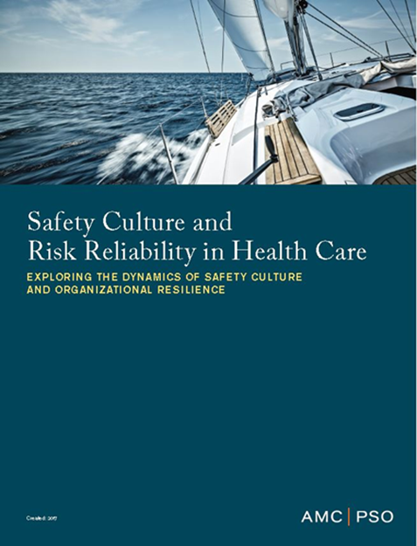
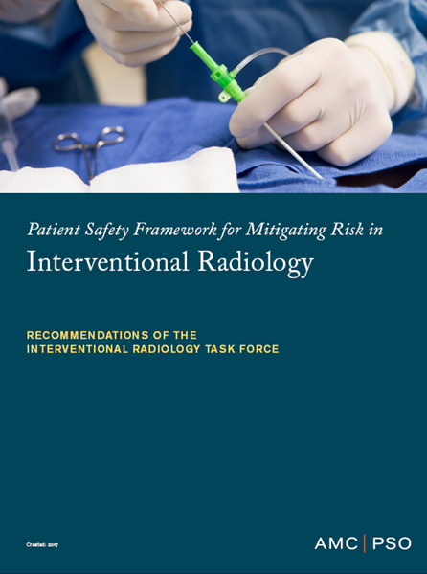
Examples of other Guidance Documents
https://www.rmf.harvard.edu/Products-and-Services/AMC-PSO-home-page

Slide 22
Contacts
Katherine Zigmont
  kzigmont@rmf.harvard.edu
Mary Devine
  mary.devine@childrens.harvard.edu
Alison Parmar
alparmar@partners.org

